Slide 1
Application mockup interface

Slide 2
List of pages:
Patient
Welcome interface: with appointment scheduler, barcode/weblink for data visualization.
Account creation and confirmation pages.
Appointment management: Scheduler/Appointment booking editor.
Payment Pages
Appointment confirmation/rejection pages.
Medical history data base.
Scan reports and data
Prescription data
Notifications/Message
My account: Personal information, contact details, and medical history.
Privacy options
Overview of appointments history.
Customer care
Message doctor/ Diagnostic center.
Doctor
Welcome interface: appointment scheduler, barcode/weblink for data visualization.
Patient details and docs upload.
Prescription and instructions entry page.
Appointment management: Schedule, view, and manage appointments.
Appointment approval/ Decline page.
Access and manage patient medical records.
Notifications: Receive alerts for new appointments, patient messages, and updates.
Reports and scan docs visualizer.
Payments management
My account: Personal information, contact details, and specialization.
privacy settings.
My account: Manage profile settings, availability, and communication preferences.
Messaging system.
Diagnostic center
Welcome interface: Overview of appointments, pending tests, and reports.
Reports Generation: Patient details and docs upload.
New Machine addition
Appointments management: Schedule, view, and manage appointments.
Appointment approval /decline pages.
My account: Center information, contact details, and services offered.
Privacy settings.
Overview of appointments History
Patient Records: Access and manage patient information.
Messaging system to communicate with patients and doctors.
Billing and Payments: Generate invoices, track payments, and manage billing details.
Notifications: Receive alerts for new appointments, pending tests, and updates.

Slide 3
Welcome Interface:
Company Name and Logo
About
Services Offered
Contact us
Test Center Login
Patient Login
Doctor Login

Slide 4
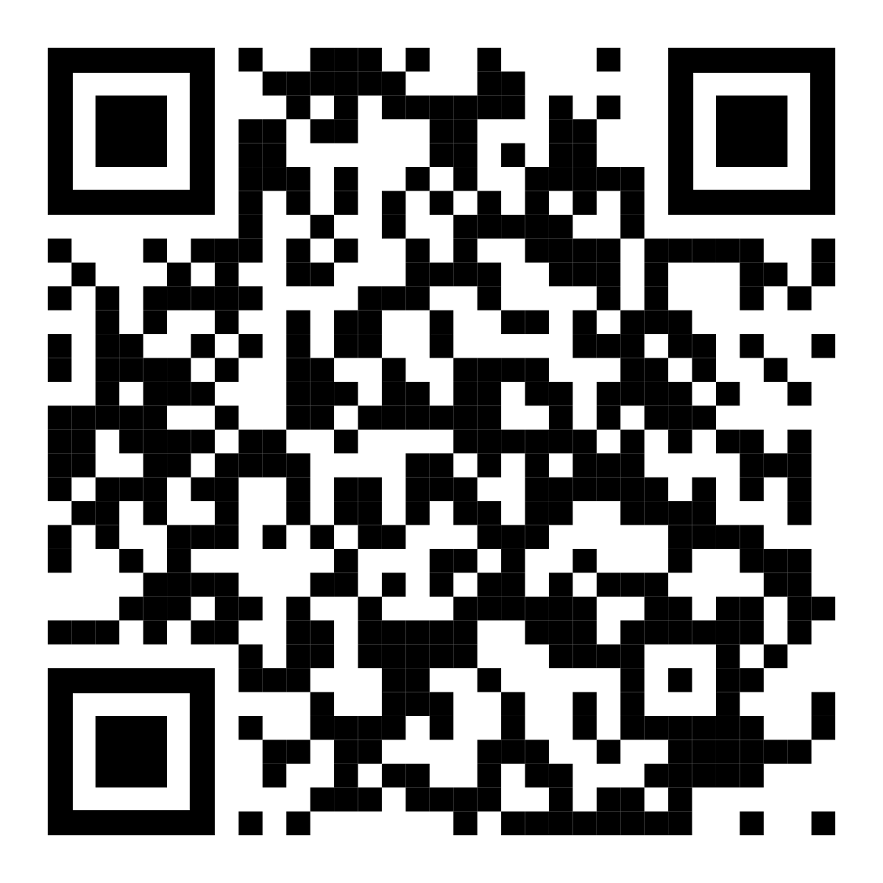
Patient Welcome Interface:
Company Name and Logo
My Appointments
My Profile
My Appointments:
Enter the link/address
Type of Appointment: Doctor / Diagnostic appointment
Type of treatment or test: Doctor / Diagnosis type
Doctor/ Diagnostic center name: Doctor type/ Diagnosis type
Status: Booked/pending/cancelled/Completed
Appointment date and time: Date and time
Get reports / Prescription
OR
Prescription
Scan data
Scan QR

Slide 5
Patient Profile creation:
Company Name and Logo
My Appointments
My Profile
Please fill the form:
First Name
Last Name
Email ID
Phone Number
Address Details
I Understand and accept the terms and conditions
Create Account

Slide 6
Patient Appointment visualizer
Company Name and Logo
My Appointments
My Profile
Book and Appointment
My Appointments:
Type of Appointment: Doctor / Diagnostic appointment
Type of treatment or test: Doctor / Diagnosis type
Doctor/ Diagnostic center name: Doctor type/ Diagnosis type
Status: Booked/pending/cancelled/Completed
Appointment date and time: Date and time
Prescription
Scan data

Slide 7
Patient Appointment Booking:
Company Name and Logo
My Appointments
My Profile
Book an Appointment
Appointment Type
↓
Treatment Type
↓
Date and time
↓
City/Location
↓
Contact
I Understand and accept the terms and conditions
Book Appointment

Slide 8
Patient Scan reports visualizer:
Company Name and Logo
My Appointments
My Profile
Scanned Docs:
Visualizer
Scanned Doc name and details
Scanned Doc name and details
Scanned Doc name and details
Scanned Doc name and details

Slide 9
Diagnostic center Welcome Interface:
Company Name and Logo
Appointments
My Profile
Patient Details:
Patient ID
Add Scanned files and reports
Patient Name
Mobile number
Mail ID
Address
machine ID
Test type
Referred doctor
Submit

Slide 10
Doctor Welcome Interface:
Company Name and Logo
My Appointments
My Profile
Hey there “Doctor Name”:
Enter the link/address
Get reports
OR
Scan QR

Slide 11
Doctor Prescription interface:
Company Name and Logo
Appointments
My Profile
Patient Details:
Prescribed Medicines:
Prescribed Tests:
Patient ID
Medicine
Test Name
Patient Name
+
Click to add medicine
+
Click to add Test
Mobile number
Mail ID
Address
machine ID
Test type
Referred doctor
Submit

Slide 12


